Slide 1
Stock Market
Predictions and Clustering
TASK 4
Final Submission
STAT-656, May 2022
Abdullatif Alnuaimi
Pooja Hari Ambrish
Sachith Kumar Janjirala

Slide 2
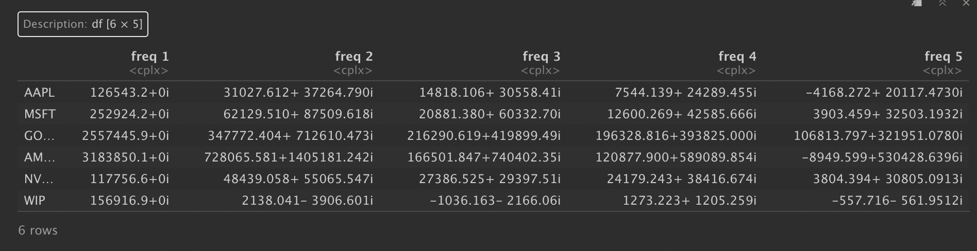
What are the 3 most interesting (to you) things you discovered about your main scientific question(s) or about the topics of this class?
First: When we perform Fast-Fourier Transforms on the stock data of the companies to extract the frequencies of the seasonality inherent in the time-series data, we observe that we get way too many frequencies as our output.
However, to perform clustering we only select the top 5 frequencies to avoid the curse of high dimensionality.
In the above output we can see the top 5 frequencies for 6 companies.

Slide 3
What are the 3 most interesting (to you) things you discovered about your main scientific question(s) or about the topics of this class?
Second: The result from clustering companies based on the frequencies of the seasonality inherent in their stock prices was inaccurate compared to the real world, indicating that clustering this way is not reliable.
This disproves our assumption from our main scientific question that companies belonging to a similar domain usually have similar market forces controlling them, therefore leading to similar frequencies in the seasonality of their stock prices seems to be reasonable

Slide 4
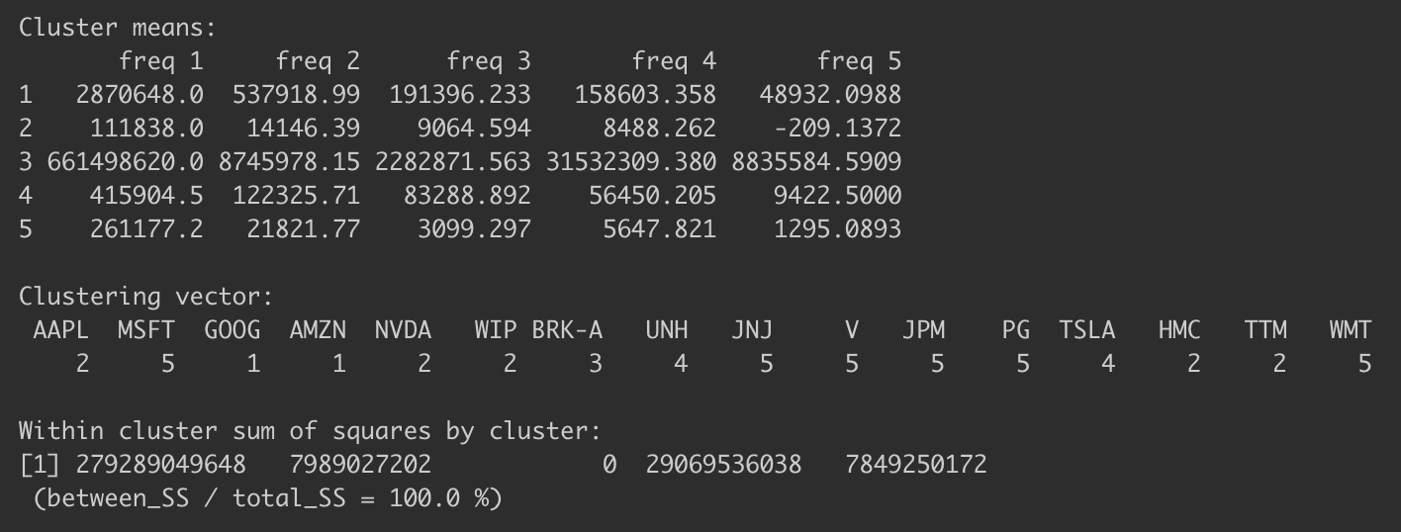
What are the 3 most interesting (to you) things you discovered about your main scientific question(s) or about the topics of this class?
Second:
The results from our analysis prove that the assumption discussed in previous slide does not hold in practice when we try to cluster the companies in such a manner as the companies falling into the same cluster often do belong to different domains while companies belonging to same domain frequently fell into different clusters.

Slide 5
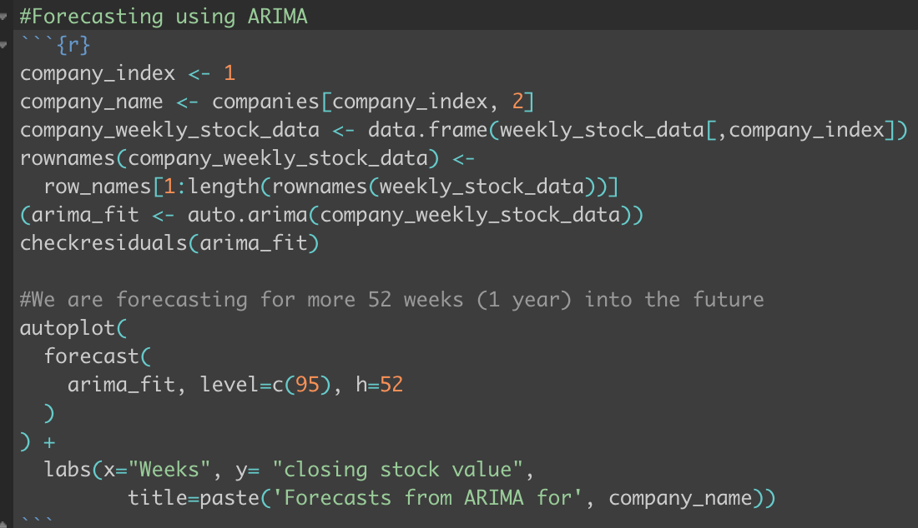
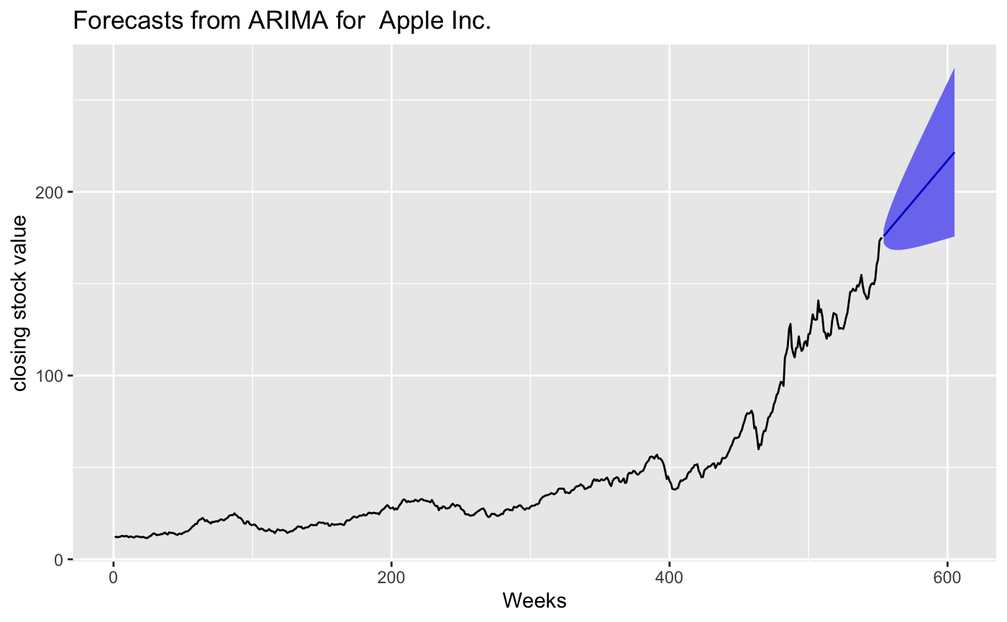
What are the 3 most interesting (to you) things you discovered about your main scientific question(s) or about the topics of this class?
Third: The forecasting of the stock value of the companies using the ARIMA model gives us a reliable way to predict the future stock values of the companies while also providing a confidence interval for those future predictions.
The above is an code of the model and its output in RStudio.

Slide 6
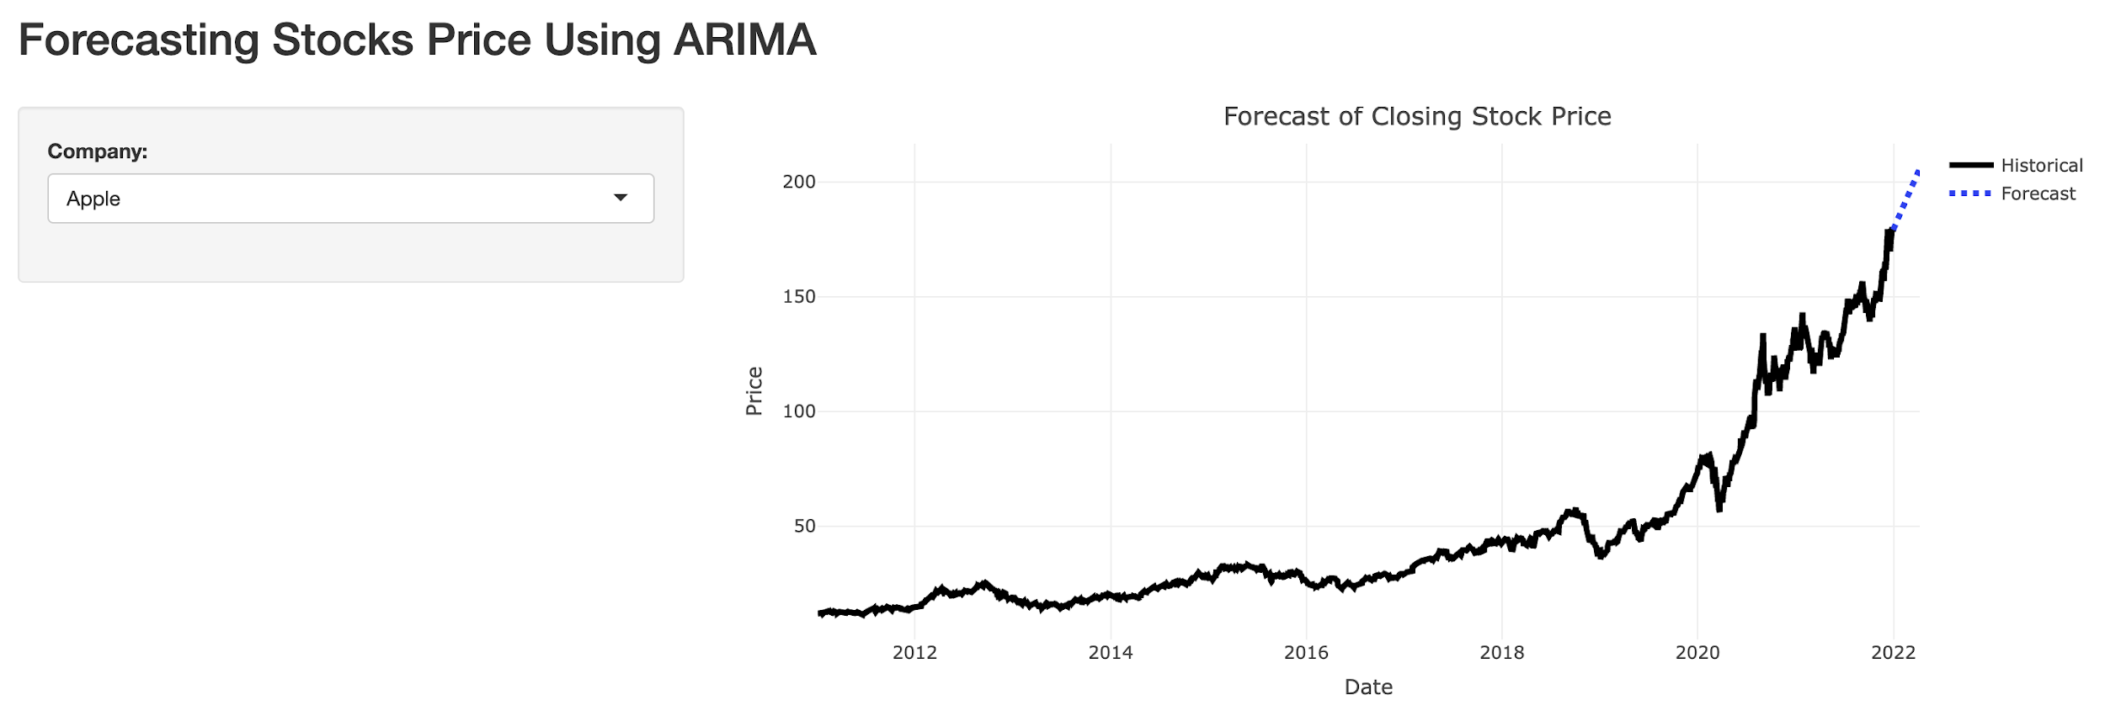
What are the 3 most interesting (to you) things you discovered about your main scientific question(s) or about the topics of this class?
Third: The forecasting of the stock value of the companies using the ARIMA model gives us a reliable way to predict the future stock values of the companies while also providing a confidence interval for those future predictions.
The above is an code of the model and its output in R Shiny App.

Slide 7
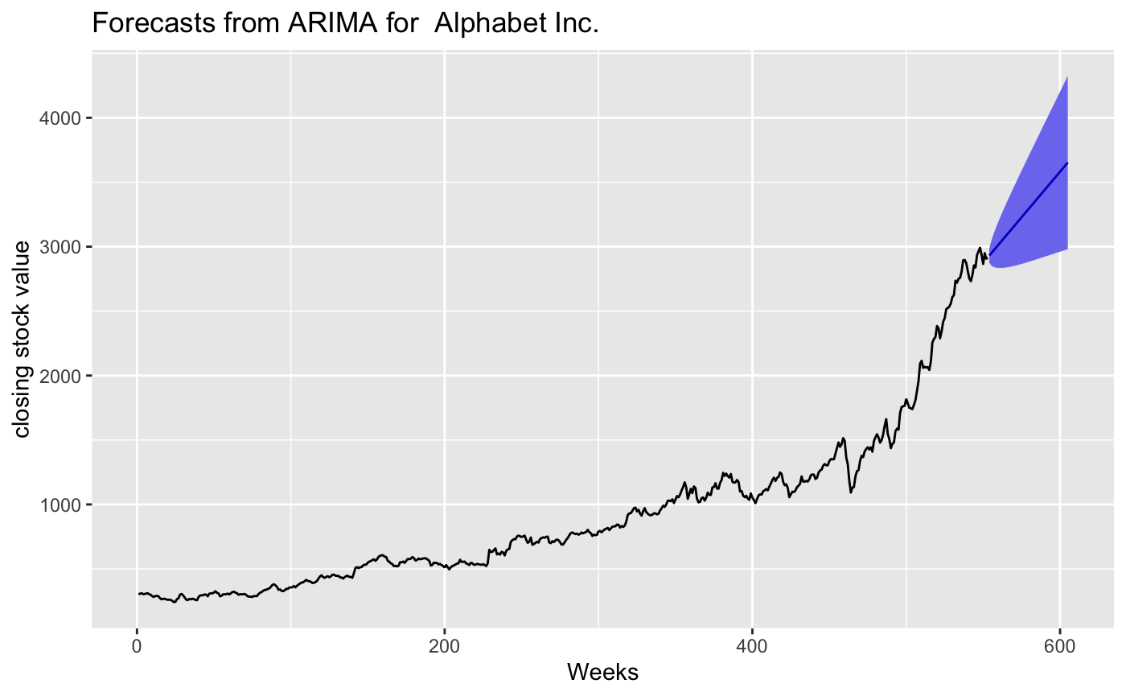
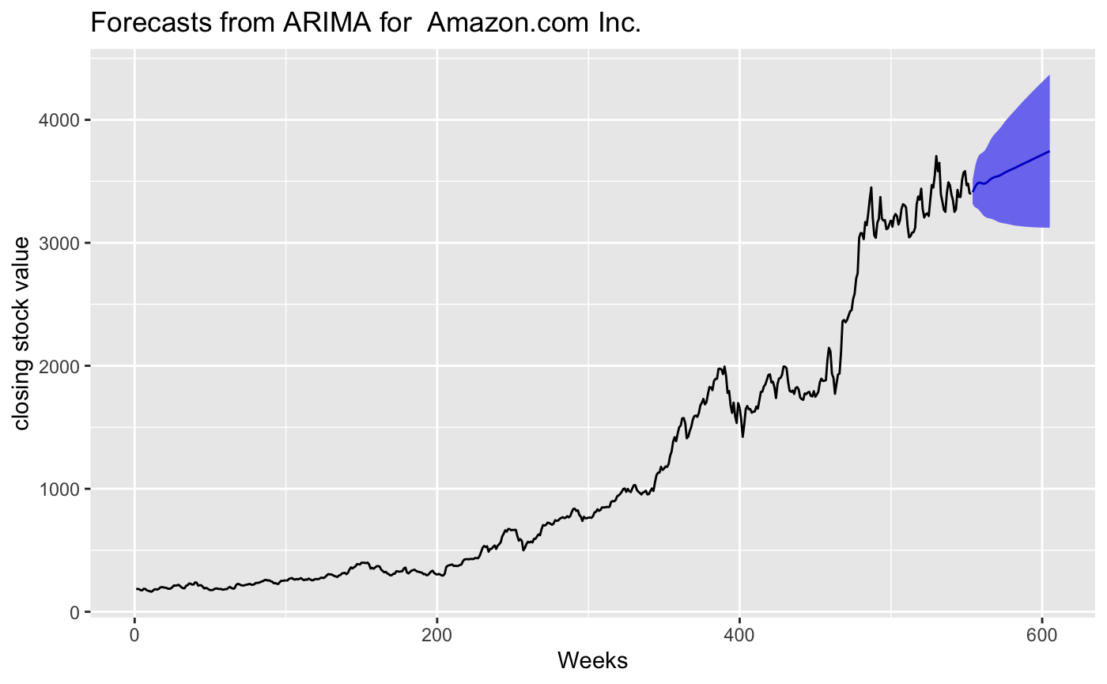
What are the 3 most interesting (to you) things you discovered about your main scientific question(s) or about the topics of this class?
Third: The ARIMA forecasting results gives us a good way to compare the companies using their future stock performances.
Here we indicate comparing of the future stock performance for the companies belonging to one of the cluster: GOOG and AMZN

Slide 8
What are the 3 most interesting (to you) things you discovered about your main scientific question(s) or about the topics of this class?
Extra: We used the Fast Fourier Transforms in R using the fft() function. The output of this function gives us a long list of frequencies from which we pick the top 5 significant frequencies.
The way we do that is in the following process :
We have also decomposed the time series stock data for each of the company using the decompose() function by using the ‘multiplicative model’ based on the observations made from the time series plots earlier.
The multiplicative model is when the variation of seasonality tends to increase with increase in time. A simplified model for time series when using multiplicative model looks like:
Time Series = Seasonal * Trend * Random

Slide 9
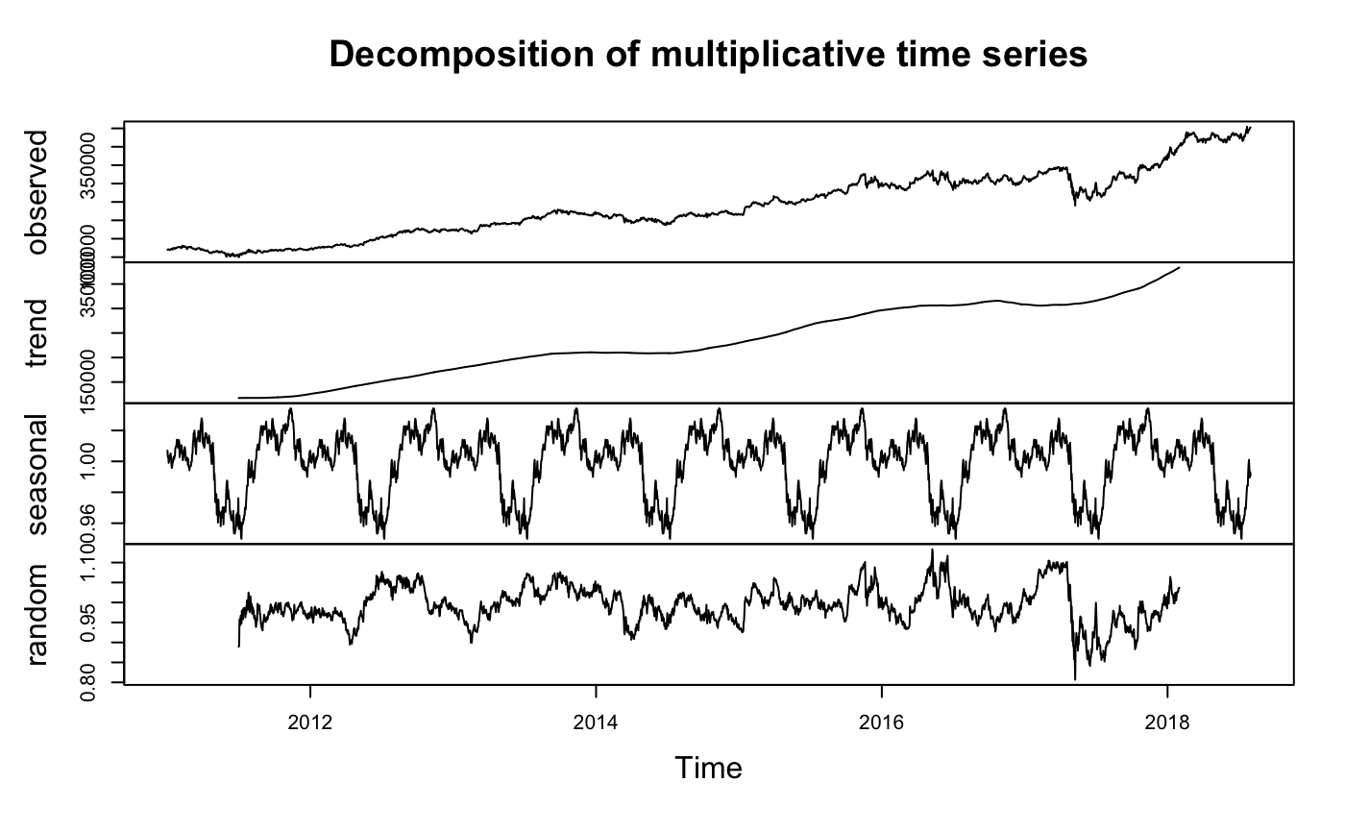
What are the 3 most interesting (to you) things you discovered about your main scientific question(s) or about the topics of this class?
Extra: The decompose() function in R yields 3 components of the time series: trend, seasonal and random, along with the observed.
Seasonal: Data with pattern that repeat with a fixed time period.
Trend: The actual underlying trend of the time series data.
Random or Residual: Noise in the data that remains.
We plot these all together using the plot() function in R.

Slide 10
What was the biggest challenge you faced in this project?
We have faced the below challenges in this project:
Biggest Challenge: Getting the R Shiny app to run was challenging because R Shiny does not provide sufficient information when giving an error in the code to be able to debug the code.
Initially we have used pdfetch() to extract data from Yahoo finance, however later this module has caused issues due to backward incompatibility after the updates. So, we have had to research for new methods to extract data and decided to use getSymbols() function from the ‘tidyquant’ library.
Not having enough background knowledge in the financial domain which would be helpful to quickly decide on which type of stock price to select as our supervisor variables from among different types of stock values: Open, High, Low, Close, Volume, Adjusted. We have read what each of them means and have selected close stock value as our supervisor variable for this project.

Slide 11
If you started the project over from the beginning right now, knowing what you know, what is a major way in which your project would have turned out differently?
We hoped to perform comparative analysis over clusters of companies by clustering them based on the frequencies of the seasonality in their stock data, based on the assumption of our main scientific question: the assumption that companies belonging to the similar domain usually have similar market forces controlling them, therefore leading to similar frequencies in the seasonality of their stock prices. However, this assumption proved to not hold in practice.
Had we known this, we would have researched a bit more in the space of finance and would have also included few other ways to cluster the companies so that we can perform comparative analysis among the companies belonging to the same clusters.

Slide 12
R Shiny app
Provide a link to a working R Shiny app that I can navigate to that displays some aspect of your project. Use this app to discuss one of the above bullet points in your presentation (See "Extra Notes" for a discussion of R shiny).
Here is the link to the working R Shiny app demonstrating our project:
https://alnuaimi107.shinyapps.io/stock-market-pnc/

Slide 13
Thank You!

